Slide 1
LLM Knowledge Share
Q3 - 2023
Raytheon Technologies Proprietary This document does not contain technology or technical data controlled under either the U.S. International Traffic in Arms Regulations or the U.S. Export Administration Regulations.

Slide 2
LLM Knowledge Share
What is an LLM in the context of DNNs?
Word Embedding
How is an LLM trained and on what data?
LLM Improvements
What is RAG and how does it work with LLMs?

Slide 3
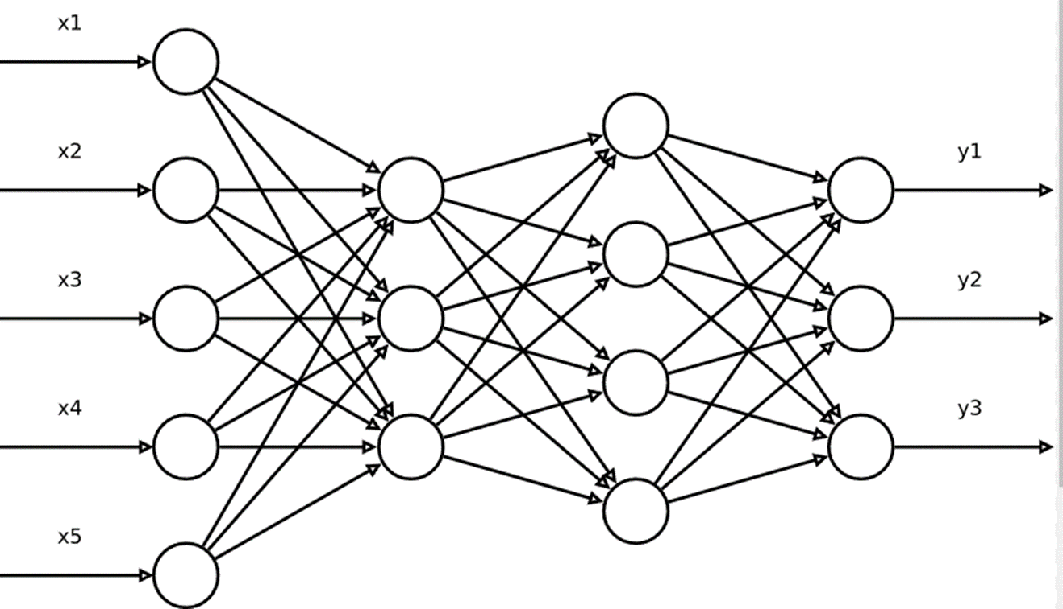
Large Language Models – LLMs
LLMs are Deep Neural Networks
Very complex structure
Input and output are numerical

Slide 4






LLMs - Embeddings
Words converted to numbers to feed them into DNNs → Embeddings
Real embeddings are 1K – 10K longs
Embeddings are close (cosine similarity) → words are semantically related
Sentences, texts can also be converted to Embeddings
z
apple
orange
teacher
student
0.50
0.45
0.31
0.34
0.20
0.19
0.92
0.89
0.90
0.87
0.60
0.62
Fruits grow in a garden
Universities offer computer classes
0.53
0.32
0
y
0.22
0.82
0.95
0.56
x

Slide 5




Embeddings
Different modalities can be converted to embeddings and we can do apple-to-apple comparison
orange
z
0.50
0.45
0.20
0.19
0.90
0.87
apple
0
y
0.31
0.34
0.92
0.89
0.60
0.62
x

Slide 6
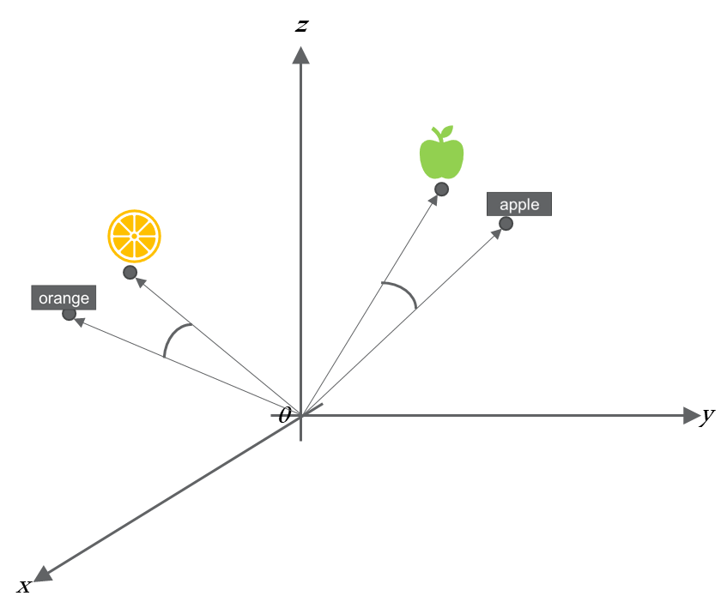


Embeddings
Different modalities can be converted to embeddings and we can do apple-to-apple comparison
orange
z
0.50
0.45
0.20
0.19
0.90
0.87
apple
0
y
0.31
0.34
0.92
0.89
0.60
0.62
x

Slide 7

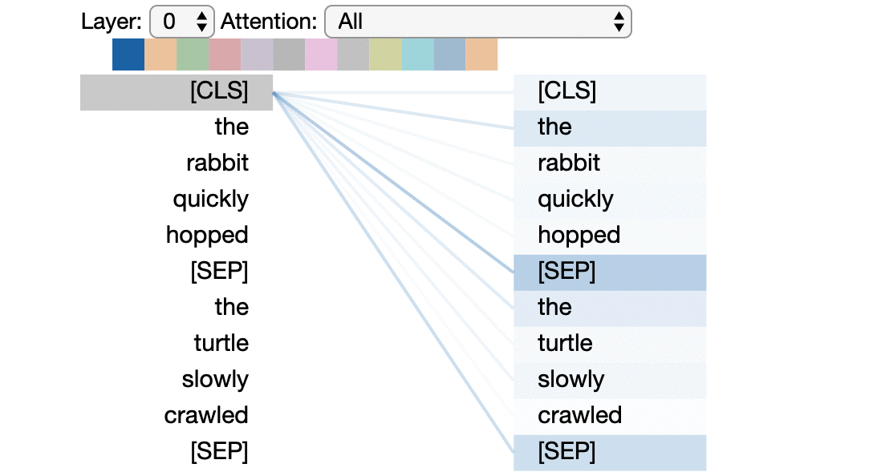
Transformers
BERT – Bidirectional Encoder Representations from Transformers
BART – Bidirectional Auto-Regressive Transformers
GPT – Generative Pre-trained Transformer

Slide 8
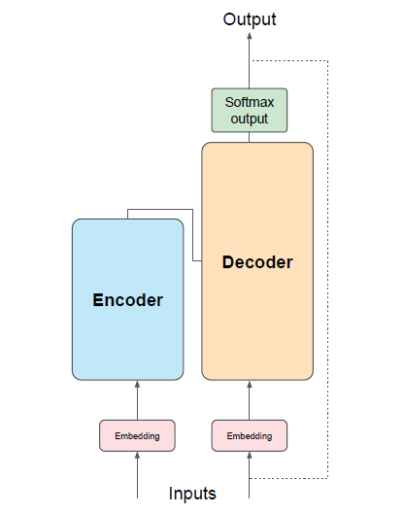
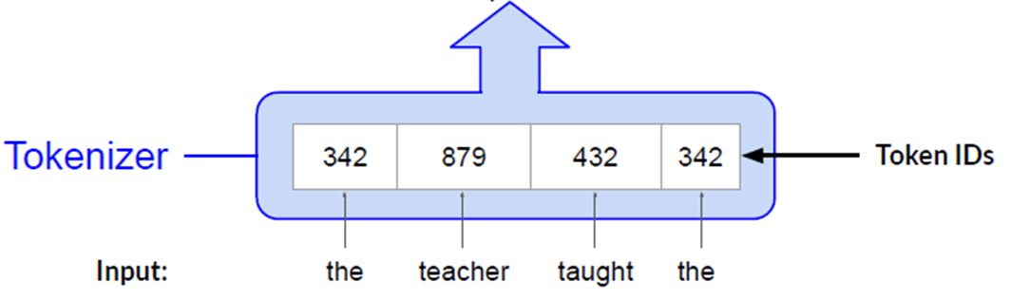
Transformers

Slide 9
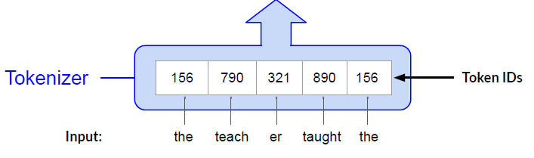
Transformers

Slide 10
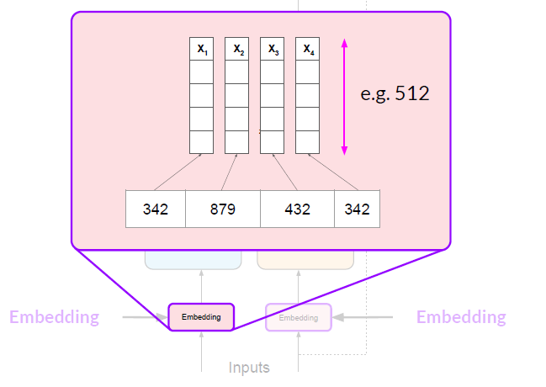
Transformers

Slide 11
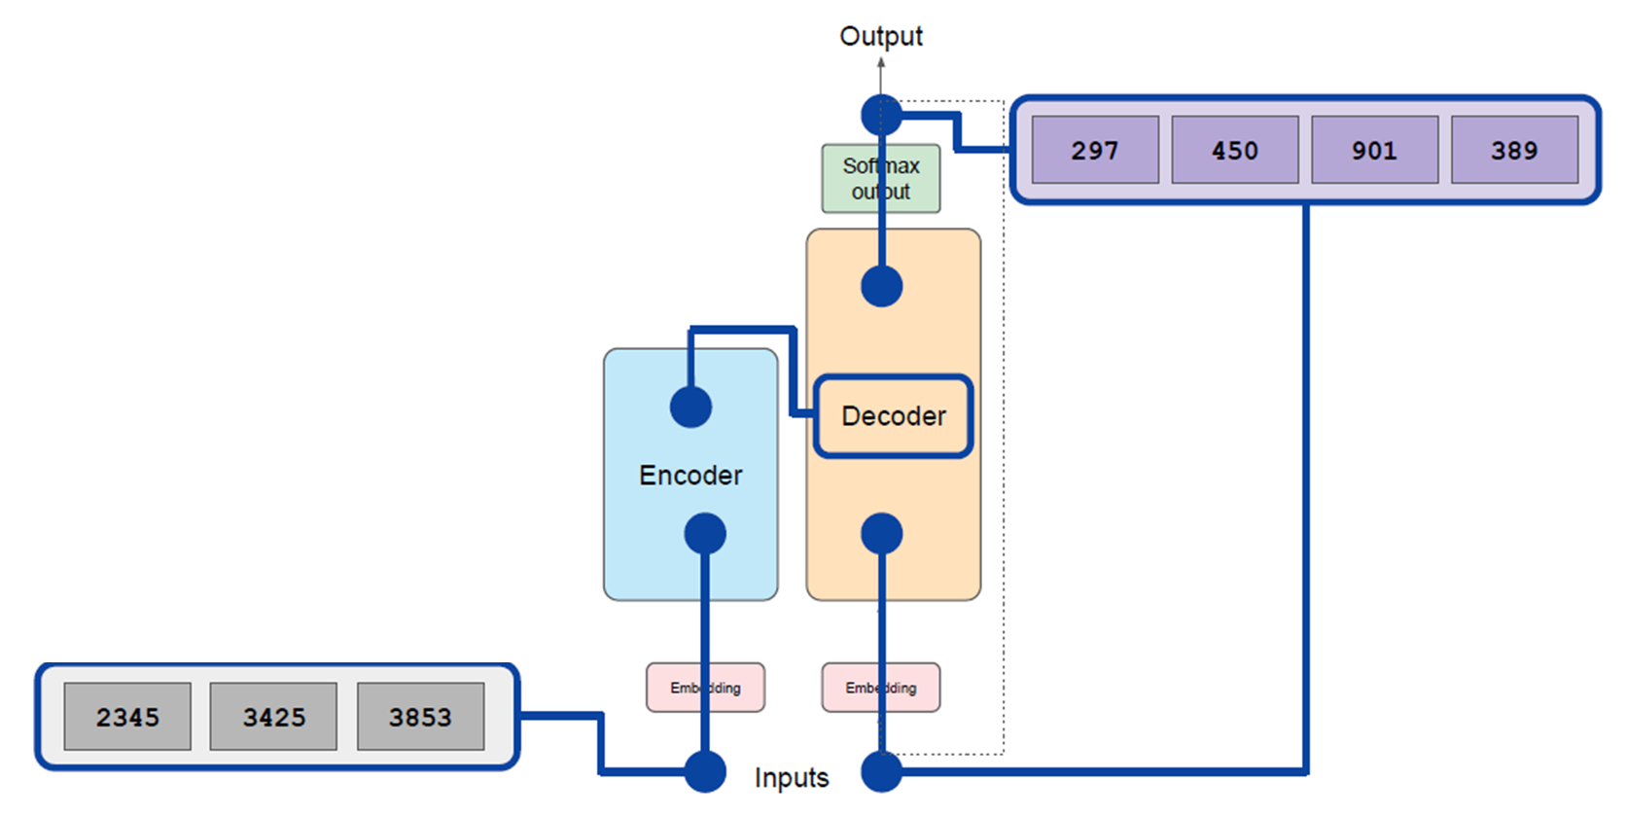
Transformers
Encoder
Encodes inputs (“prompts”) with contextual understanding
and produces one vector per input token
Decoder
Accepts input tokens and
generates new tokens.

Slide 12
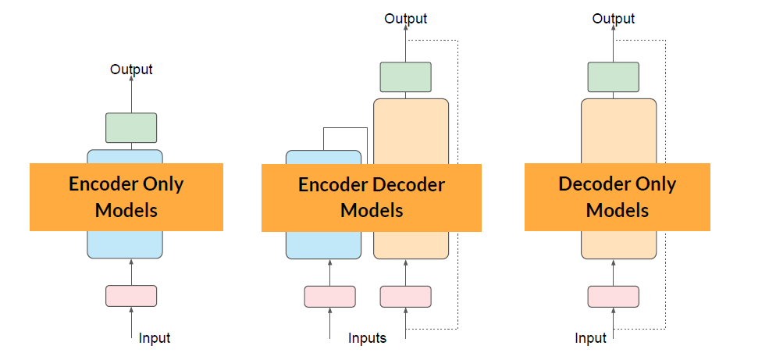
Transformers
Trained using large corpora of unlabeled text – unsupervised learning

Slide 13
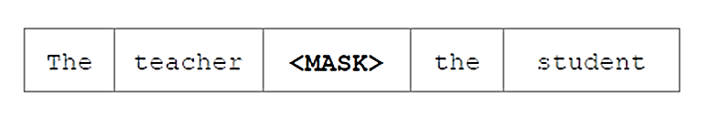
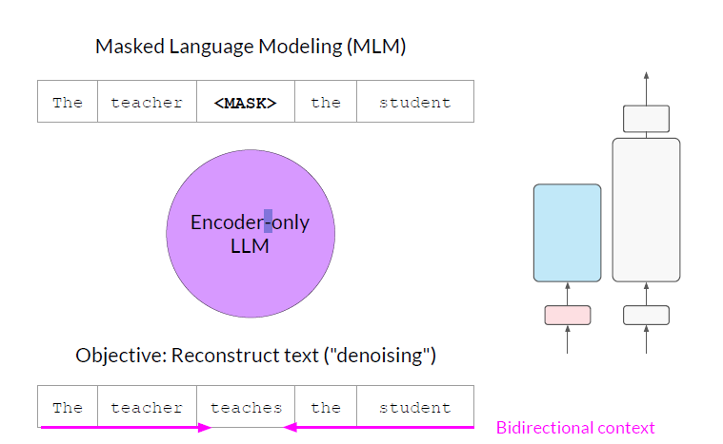
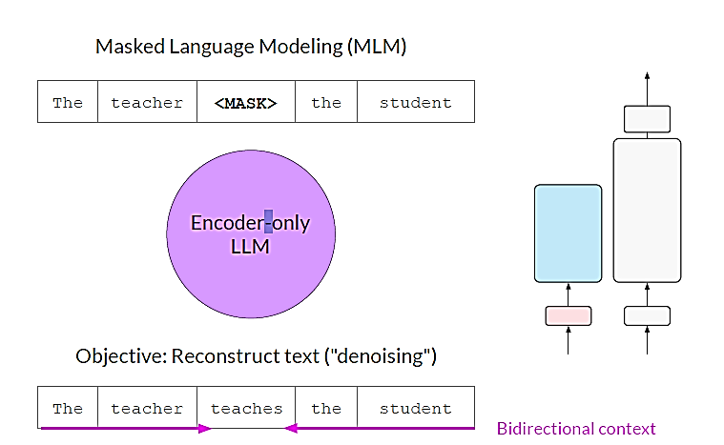
Encoder Only – Autoencoding Models
Good use cases:
Sentiment analysis
Named entity recognition
Example models:
BERT
ROBERTA
Masked Language Modeling (MLM)
Encoder-only
LLM
Objective: Reconstruct text

Slide 14
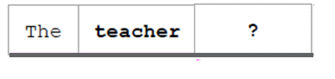
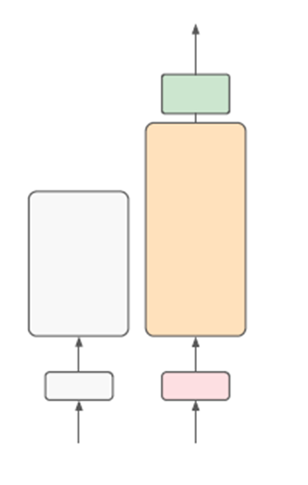
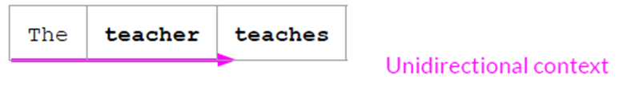
Decoder Only – Autoregressive Models
Good use cases:
Text generation
Other emergent behavior
Depends on model size
Example models:
GPT
BLOOM
Decoder-only
LLM

Slide 15
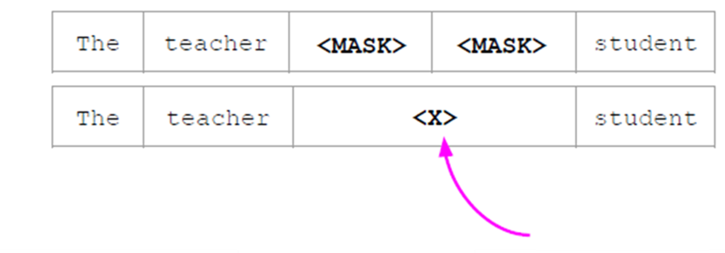
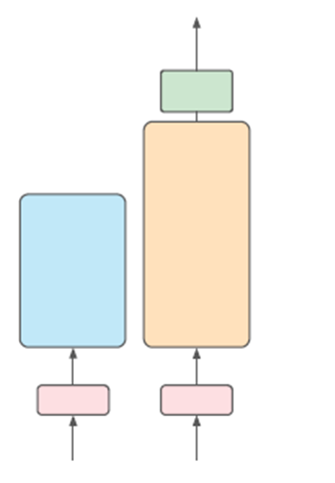
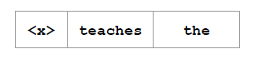
LLMs - Transformers
Good use cases:
Translation
Text summarization
Question answering
Example models:
T5
BART
Sentinel token
Encoder-Decoder
LLM
Objective: Reconstruct span

Slide 16
Transformers Training Data
Training Data – large corpora of unlabeled text – unsupervised learning
GPT-3 training data (https://www.springboard.com/blog/data-science/machine-learning-gpt-3-open-ai/)
Corpus | Quantity (tokens)
Common Crawl (filtered) | 410 billion
WebText2 | 19 billion
Books1 | 12 billion
Books2 | 55 billion
Wikipedia | 3 billion
Common Crawl corpus contains petabytes of data collected over 8 years of web crawling. The corpus contains raw web page data, metadata extracts and text extracts with light filtering.
WebText2 is the text of web pages from all outbound Reddit links from posts with 3+ upvotes.
Books1 & Books2 are two internet-based books corpora.
Wikipedia pages in the English language are also part of the training corpus.

Slide 17
LLM Improvements
Without changing the model
1. Configuration Tuning
2. Prompt engineering, few shot learning
3. Prompt enrichment with external data sources
With changing the model
Full fine-tuning
Partial fine-tuning
LoRA (Low-Rank Adaptation)
Prompt tuning

Slide 18
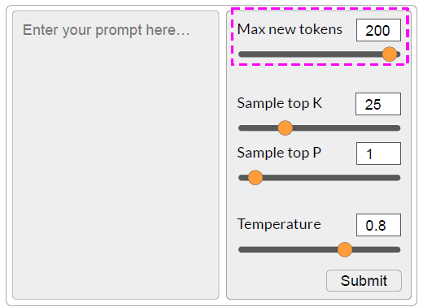
LLM Configuration Tuning
Max new tokens
Sample top K
Sample top P
Temperature

Slide 19
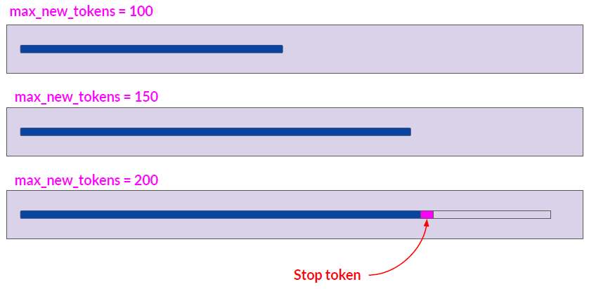
LLM Configuration Tuning

Slide 20
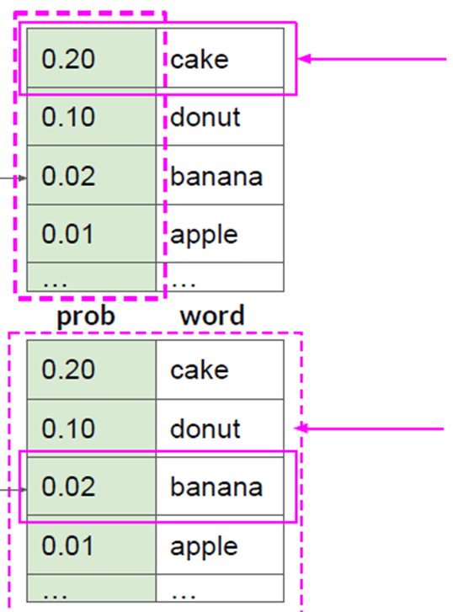
LLM Configuration Tuning
Token
Probability
Token
Greedy Sampling: the token with the highest probability is selected
Random Sampling: the token is selected based on its probability.
E.g. if sample 100 times
‘cake’ is selected ~20 times
‘donut’ is selected ~10 times
‘banana’ is selected ~2 times
‘apple’ is selected ~ 1 time
…

Slide 21
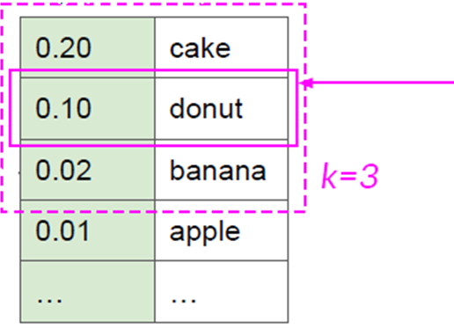
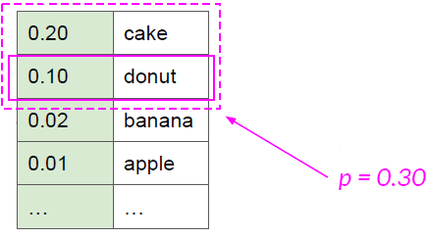
LLM Configuration Tuning
Token
Probability
Token
Top-k: applying random-weighted strategy to the k top-ranked results
Top-p: applying random-weighted strategy to the top-ranked consecutive results and with a cumulative probability <= p

Slide 22
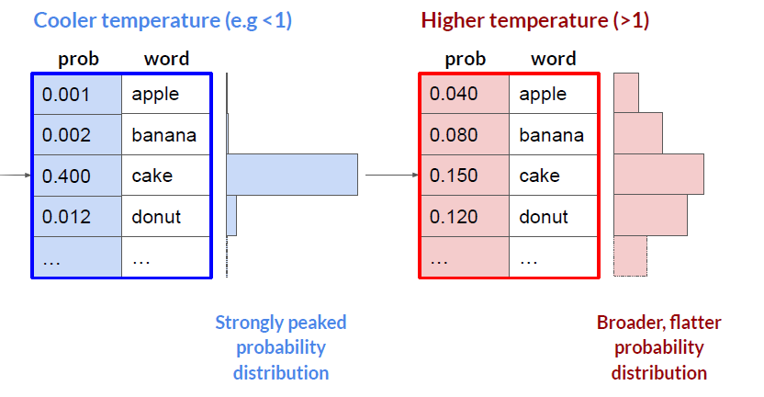
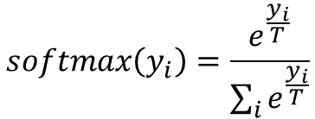
LLM Configuration Tuning
$$softmax\left(y_{i}\right)=\frac{e^{\frac{y_{i}}{T}}}{\sum_{i}{e^{\frac{y_{i}}{T}}}}$$

Slide 23

Fine-tuning LLM
Fine-tuning data
New data
Proprietary data
Specific domain data
Fine-tuned
LLM
Training data
Fine-tuned
LLM
Base Model
Pre-trained
LLM
Fine-tuned
LLM

Slide 24
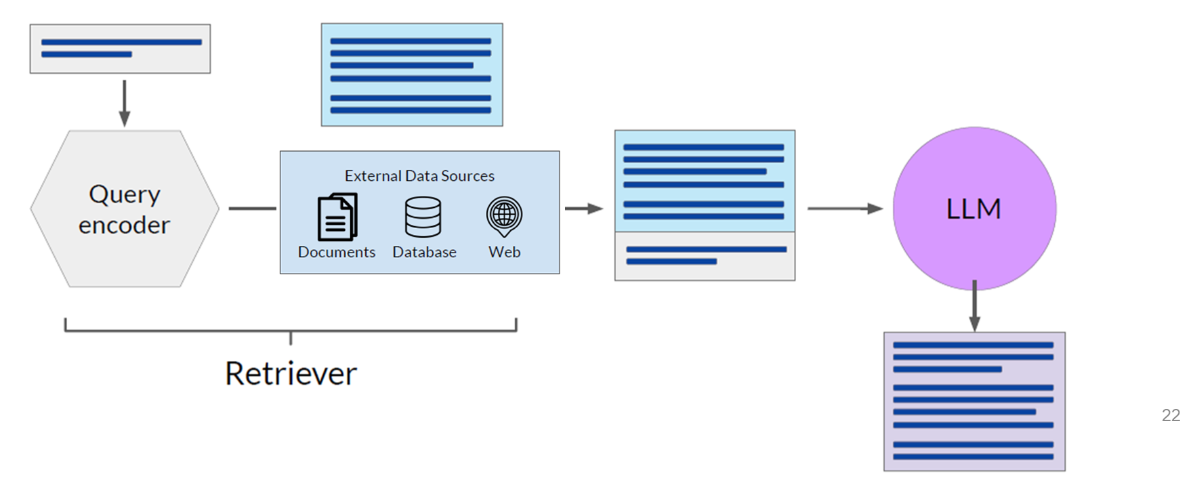
Retrieval Augmented Generation (RAG)
Give the pre-trained model access to additional external data at inference time
Retrieval Augmented Generation is a framework for building LLM powered systems that make use of external data sources
Enhance initial prompt with additional information from external data sources
New data
Proprietary data
Specific domain data
Notes:
RAG is a great way to overcome the knowledge cutoff issue and
help the model update its understanding of the world.
While you could retrain the model on new data,
this would quickly become very expensive.
And require repeated retraining to regularly update the model with new
knowledge.
A more flexible and less expensive way to overcome knowledge cutoffs is to
give your model access to additional external data at inference time.
RAG is useful in any case where you want the language model to have access to
data that it may not have seen.
This could be new information documents not included in the original training
data, or proprietary knowledge stored in your organization's private databases.
Providing your model with external information,
can improve both the relevance and accuracy of its completions.
Retrieval augmented generation isn't a specific set of technologies, but rather
a framework for providing LLMs access to data they did not see during training.

Slide 25
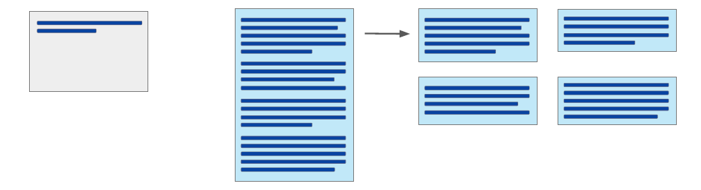
Data Preparation for RAG
Data must fit inside the context window
Data must be in format that allows its relevance to be evaluated at inference time: Embedding vector
Prompt context limit
few 1000 tokens
Single document too
large to fit in window
Split long sources into
short texts

Slide 26



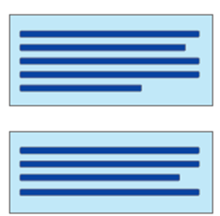
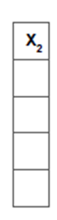
Data Preparation for RAG
Data must fit inside the context window
Data must be in format that allows its relevance to be evaluated at inference time: Embedding vector
Prompt is converted to an embedding vector
z
Prompt
Text 1
Text 2
Each text is converted to an embedding vector
0
y
x

Slide 27
RAG – Vector Databases
z
Text 4
Text 3
Vector database – a vector store where each vector is also identified by a key.
The text generated by RAG includes a citation for the document from which it was received.
Prompt
Text 1
Text 2
Text 6
0
y
Text 5
Text 7
x

Slide 28
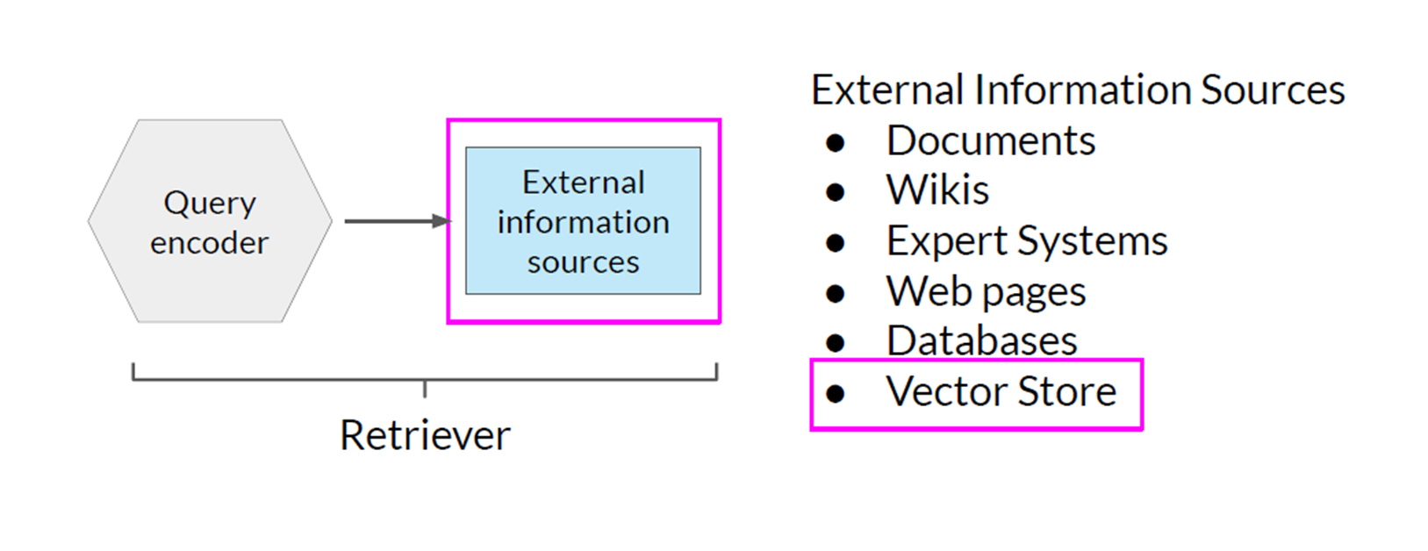
Retrieval Augmented Generation (RAG)

Slide 29
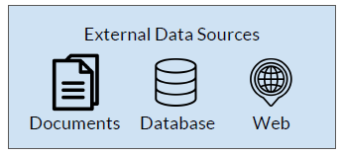
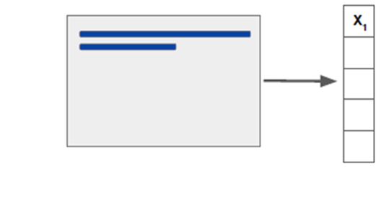

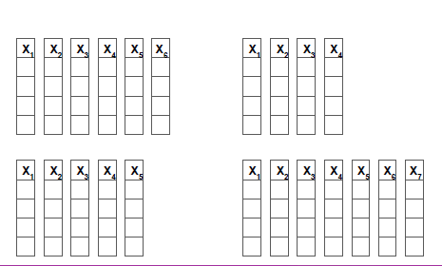
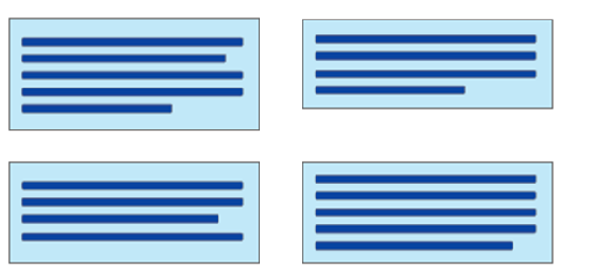

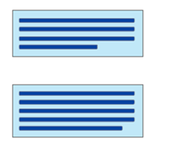
RAG with a Vector Store
Initial Prompt
Links
source documents
to embeddings
Offline processing
LLM
Vector Store/Vector Database

Slide 30
LLM – Summary
LLMs are trained to produce statistically plausible continuation/completion of input text (prompts)
LLMs use Embedding vectors to identify semantically related texts
LLMs are very time-consuming and expensive to train from scratch
Fine-tuning can be used to produce LLMs that are up-to-date and/or have knowledge in specialized domains – even that can be time-consuming and expensive
RAG methods are used to help pre-trained LLMs to stay up-to-date and to answer questions in specialized domains without retraining or fine-tuning
RAG methods take small chunks of external data and process them through the LLM to create Embedding vectors for each chunk
Embedding vectors are stored in vector databases
Vector databases provide fast searching and efficient identification of semantically related text
Initial prompts enriched with semantically related text from external sources are submitted to pre-trained LLMs for processing

Slide 31
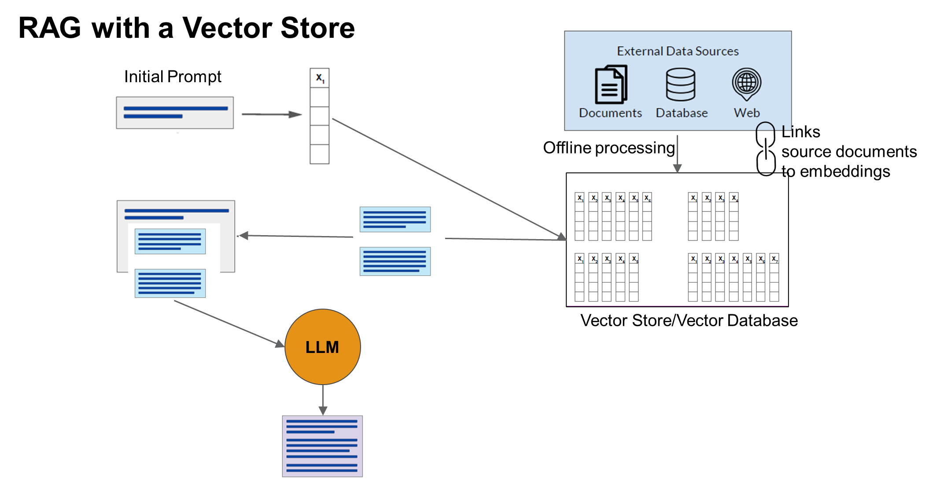

Slide 32
Backup

Slide 33
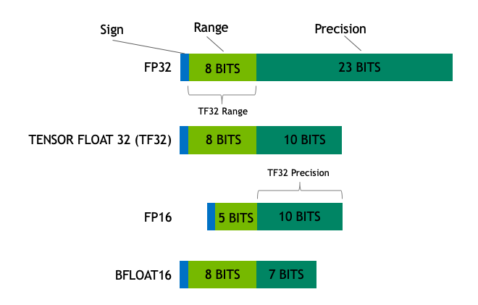

Slide 34

One Shot Prompting
Template
Input variable names
Prompt_template
Input variables
Prompt
Chain
LLM
run
output

Slide 35
Few Shot Prompting
Example Template
Input variable names
Prompt_template
Prompt
Examples
Prompt
formatter
Prompt
template
Few Prompt_template
Prompt
Prefix
Prompt
Suffix
Input variable names
Input variables
Chain
output
LLM
run

Slide 36
Chain of ThoughtPrompting
Example Template
Input variable names
Prompt_template
Prompt
Examples
Few Prompt_template
Prompt
Prefix
output
LLM
Chain
run
Suffix
Input variable names
Input variables

Slide 37
Vector Databases/Datastores
AnalyticDB
Chroma
DeepLake
FAISS
LanceDB
Milvus
Pinecone
Qdrant
SupabaseVectorStore
Weaviate
Zilliz

Slide 38
AnalyticDB https://github.com/openai/chatgpt-retrieval-plugin/tree/main/docs/providers/analyticdb
AnalyticDB is a distributed cloud-native vector database designed for storing documents and vector embeddings. It is a high-performance vector database that is fully compatible with PostgreSQL syntax, making it easy to use. Managed by Alibaba Cloud, AnalyticDB offers a powerful vector compute engine, processing billions of data vectors and providing a wide range of features, including indexing algorithms, structured and unstructured data capabilities, real-time updates, distance metrics, scalar filtering, and time travel searches. Additionally, it offers full OLAP database functionality and an SLA commitment for production use.
AnalyticDB for PostgreSQL https://www.alibabacloud.com/help/en/analyticdb-for-postgresql
AnalyticDB for PostgreSQL (formerly known as HybridDB for PostgreSQL) is a fast, easy-to-use, and cost-effective warehousing service that can process petabytes of data. AnalyticDB for PostgreSQL uses the MPP architecture and is compatible with Greenplum Database and PostgreSQL and Oracle syntax.

Slide 39
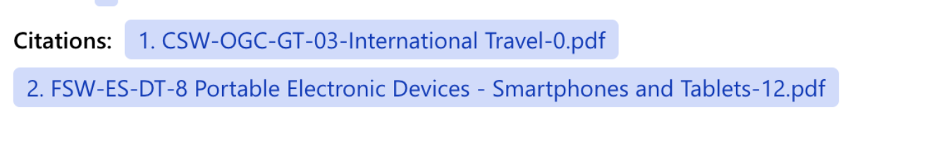

Slide 40
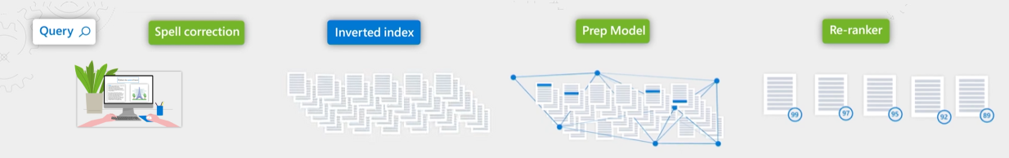
Semantic Search
TF-IDF-like retrieval functions that use the term frequency (TF) and the inverse document frequency (IDF) as variables to calculate relevance scores for each document-query pair, which is then used for ranking results.
The semantic models don't compose new sentences or phrases from the available content, nor does it apply logic to arrive at new conclusions. In short, the system will never return content that doesn't already exist.
Default scoring (BM25Similarity)
Accepts up to 1000 input documents
Returns top 50 ranked results
Semantic search
Preprocessing: Each document is converted to a long string which is trimmed at 128 unique tokens
Best summarizers extraction: extracts 2 passages: semantic caption and semantic answer extract the passage (semantic caption) from the document that best summarize the document relative to the query
Semantic ranker re-ranks the documents

Slide 41
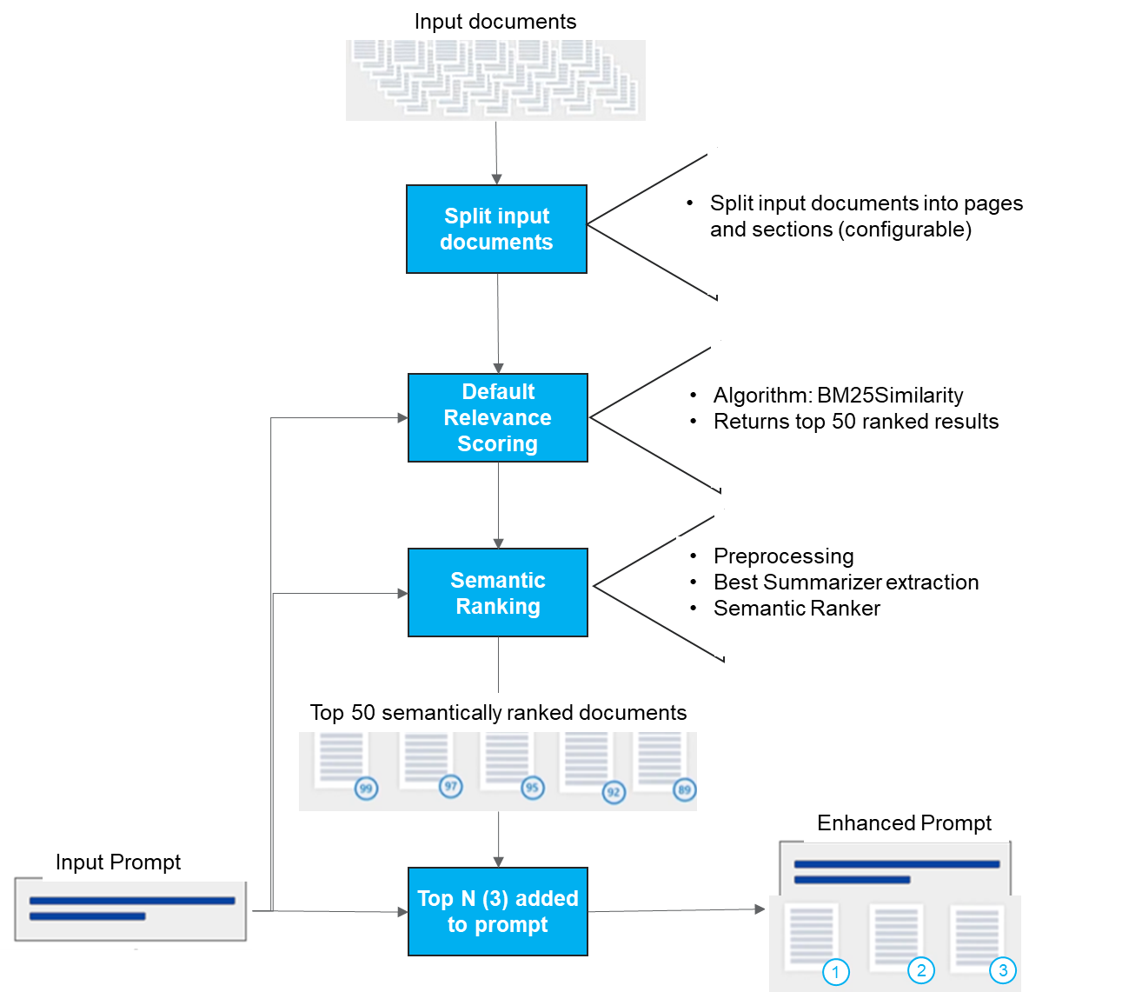

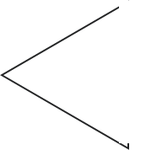

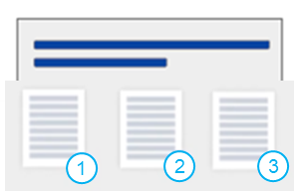

Input documents
TF-IDF-like retrieval functions that use the term frequency (TF) and the inverse document frequency (IDF) as variables to calculate relevance scores for each document-query pair, which is then used for ranking results.
The semantic models don't compose new sentences or phrases from the available content, nor does it apply logic to arrive at new conclusions. In short, the system will never return content that doesn't already exist.
Split input documents
Split input documents into pages and sections (configurable)
Details of Default Relevance Scoring
1. Default Relevance scoring is part of Full text search in Azure Cognitive Search
2. BM25 uses TF-IDF, or term frequency-inverse document frequency, to compute the relevance score for each prompt-section pair. (more details on BM25 can be found here).
3. The sections are ranked using this relevance score. The number of returned sections is limited to 50 by default in order to maintain the fast performance of Semantic Ranking. It can be increased to 1000 sections.
Details of Semantic Ranking
1. Preprocessing: Each Section is converted to a long string which is trimmed at 128 unique tokens
2. Best Summarizers extraction. Extracts 2 passages: semantic caption and answer. Semantic caption is a passage from the section that best summarize the section relative to the query
3. Semantic ranker re-ranks the sections using a proprietary language model that compares semantic caption with the prompt. Returns whole sections along with the captions and answers. The actual details of the is process is proprietary, most likely a proprietary Microsoft LLM converts the sections and prompts to embeddings and computes the cosine similarity. (The 128 token limit is possibly because of the limitation of this model)
4. The top N (3 by default) sections are used to enhance the prompt.
Note. The semantic models don't compose new sentences or phrases from the available content, nor does it apply logic to arrive at new conclusions. In short, the system will never return content that doesn't already exist.
1. Preprocessing: Each document is converted to a long string which is trimmed at 128 unique tokens
2. Best summarizers extraction. Extracts 2 passages:
semantic caption and extract the passage (semantic caption) from the document that best summarize the document relative to the query
semantic answer
3. Semantic ranker re-ranks the documents using a language model to compare semantic caption with the query. Returns whole documents
Default Relevance Scoring
Algorithm: BM25Similarity
Returns top 50 ranked results
Semantic Ranking
Preprocessing
Best Summarizer extraction
Semantic Ranker
Top 50 semantically ranked documents
Enhanced Prompt
Input Prompt
Top N (3) added to prompt

Slide 42
Input documents
davinci Prompt Template
Generate a search query based on the conversation and the new question.
davinci
Semantic Search
Chat history
Chat history
gtp-3.5 Prompt Template
Answer ONLY with the facts listed in the list of sources below.
New Question
gpt-3.5-turbo
Response

Slide 43
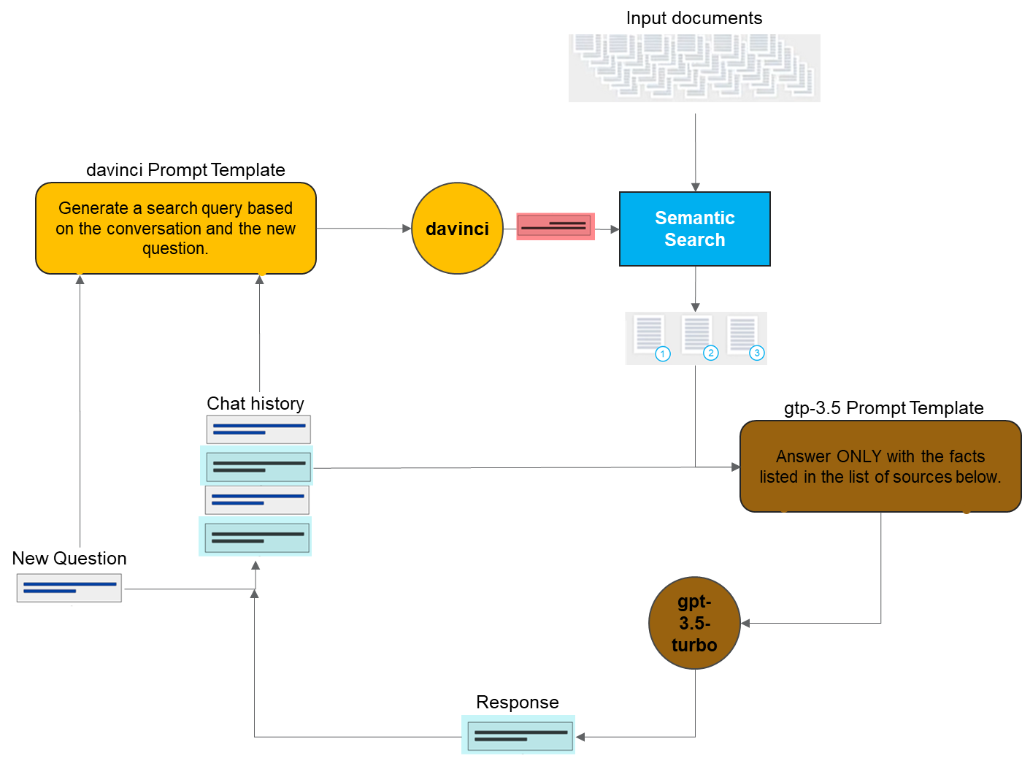

Slide 44
LLMs - Embeddings
Different modalities can be converted to embeddings and we can do apple-to-apple comparison
z
0.50
0.20
0.90
orange
0.45
0.19
0.87
0.30
0.50
0.60
0
y
apple
0.34
0.49
0.62
x

Slide 45
LLMs
BERT Bidirectional Encoder Representations from Transformers
BART Bidirectional Auto-Regressive Transformers
BLOOM
GPT Generative Pre-trained Transformer
Pathways Language Model (PaLM)
LLaMA - Large Language Model Meta AI
Multi-Genre Natural Language Inference (MultiNLI)
Foundation models are AI models trained on huge amounts of unlabeled datasets that can be used to solve multiple downstream tasks. For example, Foundation models trained on the text data can be used to solve problems related to text like Question Answering, Named Entity Recognition, Information Extraction, etc.
GPT uses 12288 dimensions.
Furthermore, GPT-4 has a maximum token limit of 32,000 (equivalent to 25,000 words),
Typical examples of LLMs include OpenAI’s GPT-4, Google’s PaLM, and Meta’s LLaMA. There is some ambiguity about whether to refer to specific products (such as OpenAI’s ChatGPT or Google’s Bard) as LLMs themselves, or to say that they are powered by underlying LLMs.
This is in contrast to many other AI systems, which are specifically trained and then used for a particular purpose.
Foundational models can be further fine-tuned for a specific task

Slide 46
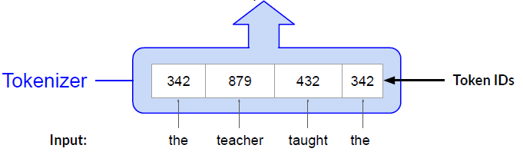
LLMs - Embeddings

Slide 47
NLP Problems
Inference different types of inferences: classification, translation, text completion, question answering
Traditional NLP problems:
Classification: In text → out class
Translation: in text → out text
Semantic search: in small base text + bunch of small texts → out small texts ranked by how similar they are to the base text
Zero-shot classification is when the label wasn’t used to train the data. It was trained to classify the data by finding which word out of a list of words is the best match to the text
candidate_labels = ['travel', 'cooking', 'dancing', 'exploration’]
classifier(sequence_to_classify, candidate_labels, multi_class=True)
#{'labels': ['travel', 'exploration', 'dancing', 'cooking’],
# 'scores': [0.9945111274719238,
# 0.9383890628814697,
# 0.0057061901316046715,
# 0.0018193122232332826],
# 'sequence': 'one day I will see the world'}

Slide 48
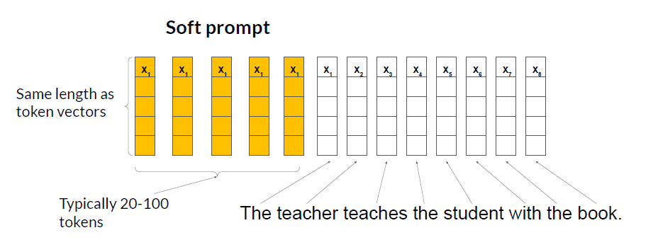
LLM Prompt Tuning
Prompt tuning is not prompt engineering!
Soft prompts can be tasks/domain specific
Just replace the soft prompts in the pre-trained model and use it for a different domain

Slide 50
LLM in HuggingFace

Slide 51
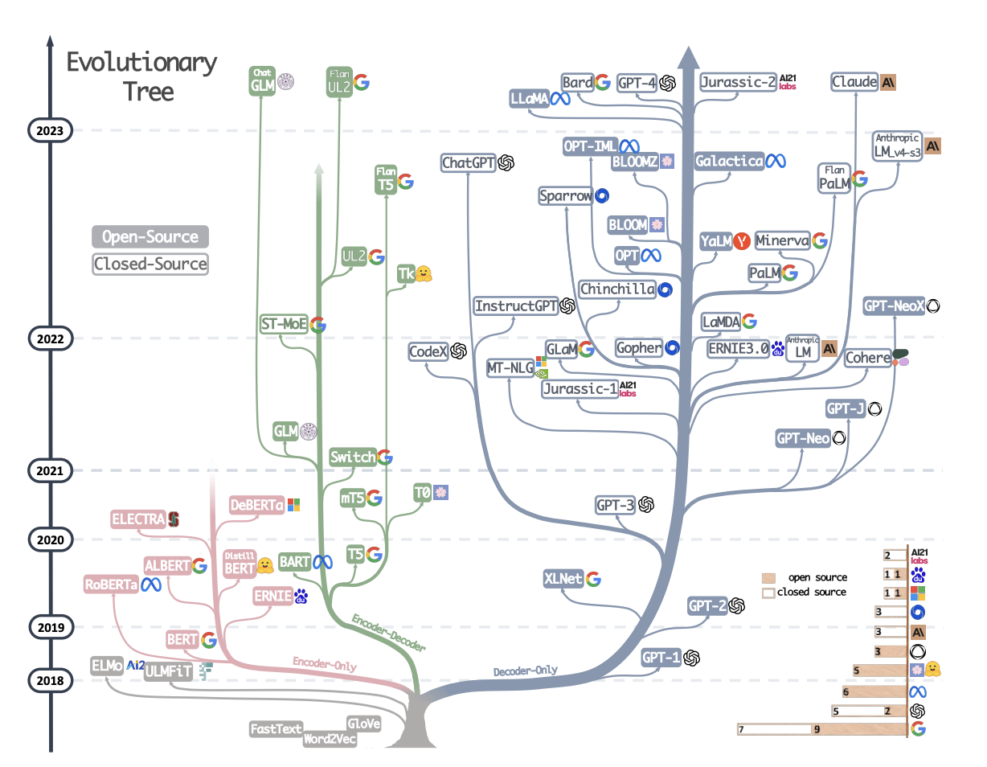
LLMs History

Slide 52
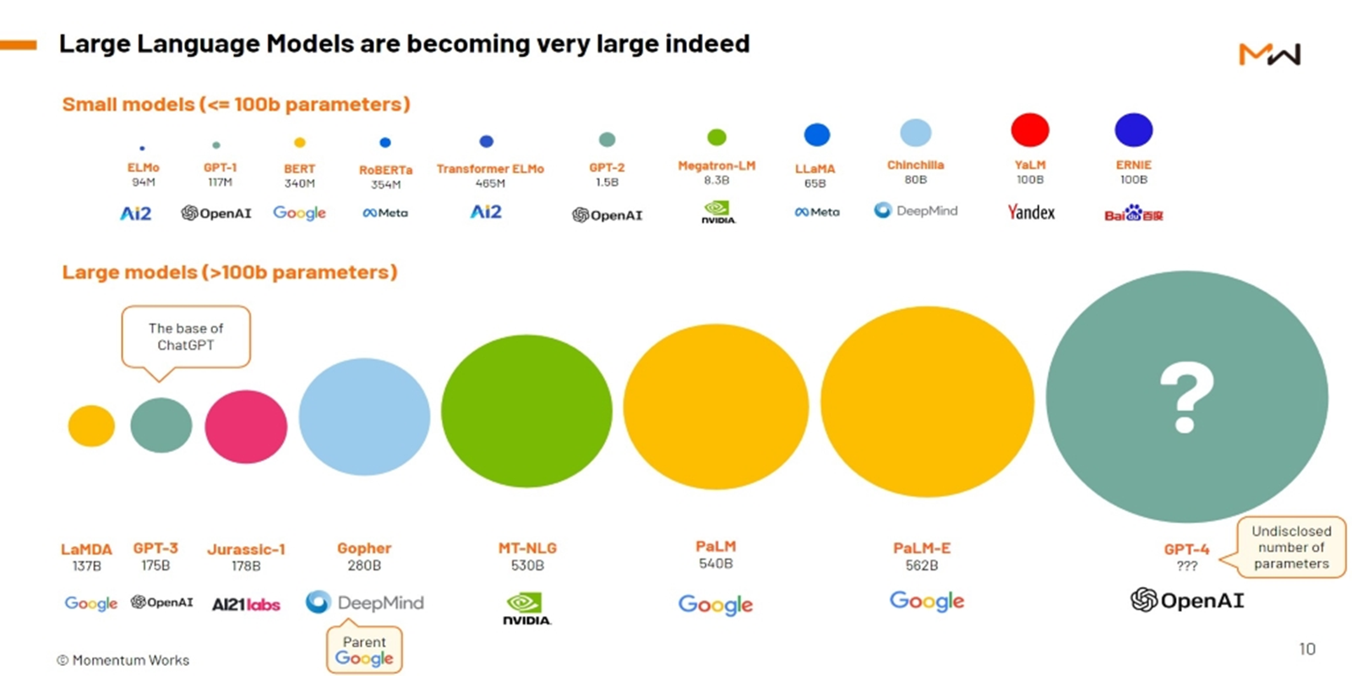
LLMs by Size

Slide 53
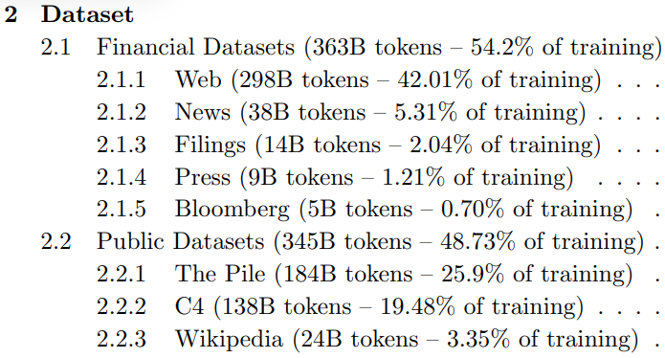
LLM Training Data Example for BloombergGPT

Slide 54
LLM in HuggingFace
Natural Language Processing
Text Classification
Token Classification
Table Question Answering
Question Answering
Zero-Shot Classification
Translation
Summarization
Conversational
Text Generation
Text2Text Generation
Fill-Mask
Sentence Similarity

Slide 55
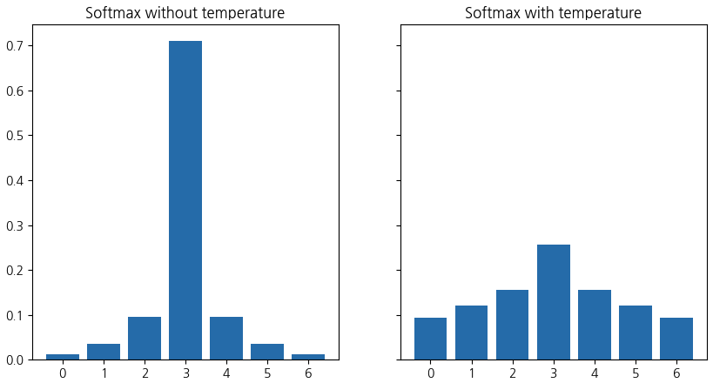
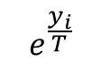

LLM Softmax
$$softmax\left(y_{i}\right)=\frac{e^{\frac{y_{i}}{T}}}{\sum_{i}{e^{\frac{y_{i}}{T}}}}$$
$$e^{\frac{y_{i}}{T}}$$

Slide 56
LangChain Going beyond simple model use
LangChain is a framework for developing applications powered by language models.
The most powerful and differentiated applications will not only call out to a language model, but will also be:
Data-aware: connect a language model to other sources of data
Agentic: allow a language model to interact with its environment
Prompt Management
Chain together models and apps

Slide 57


Notes:
ESP Policy english only-4.pdf
Participation in the Program is dependent on the Eligible employee submitting Acceptable Grade(s) at the completion of each class/subject. For MOOCs, Eligible employees will submit certificate of completion or assessment at the completion of each class/subject to receive reimbursement. I. Eligible employees wishing to pursue degree programs requiring Special Work Accommodations must use vacation time2 with supervisor approval. Special Work Accommodations include time away from work to attend degree programs with a residency, travel, domestic and/or international trips that cannot be satisfied outside of working hours. Subject to applicable law and regulation, Eligible employees 2 In jurisdictions outside of the United States and Canada, contact your local HR manager for applicable definition of vacation time. Unpublished Work • Raytheon Technologies Corporation 2021 Page 5 of 10 Raytheon Technologies must use vacation time (not to exceed annual vacation allotment and not to exceed 10 business days) and are solely responsible, without reimbursement from RTX, for all travel, meals and/or
ESP Policy english only-4.pdf
Corporation 2021 Page 5 of 10 Raytheon Technologies must use vacation time (not to exceed annual vacation allotment and not to exceed 10 business days) and are solely responsible, without reimbursement from RTX, for all travel, meals and/or lodging expenses incurred. Educational Paid Time off (“EPTO”) may not be used for Special Work Accommodations. See also Educational Paid Time Off (Section 5 below). Absence With Permission (AWP) and Personal Time may not be used for Special Work Accommodations. J. Doctorate level programs require RTX Sponsorship as outlined in the Exceptions section elsewhere in this Policy. K. Violations of this Policy can result in disciplinary action, which may include termination from the Program. 3. Payments A. The Program pays Tuition for eligible classes/subjects directly to the Accredited Educational Institution for active full- or part-time Eligible employees or those Eligible employees on a military leave of absence. Payments are subject to the applicable Maximum Annual Limits. The Program does not provide coverage for travel, meals and/or lodging expenses for Eligible employees wishing to pursue programs with Special Work Accommodations.
113.-2.pdf
2 Eligibility 4.2.1 To be eligible for a paid holiday, an employee must work the regularly scheduled workdays immediately before and after the holiday. Holiday pay will also be granted providing the employee is: 1. Absent due to personal illness or injury on either the day before or after the holiday, but not both. 2. Absent due to vacation taken in conjunction with the holiday, providing the employee must have worked the day before or after the vacation/ holiday period. 3. Granted a leave of absence ending the day before or starting the day after the holiday. 4. Absent both days for Military Duty, Jury Duty, Funeral Leave, or as a candidate for, or member of a Public Office. 5. Excused from work for a substantial reason by the Department Manager on either the day before or after the holiday. 6. Retired the day preceding the holiday has attained age 55, and the recognized holiday occurs in the same month as the employee’s last day of work. Document Number: SPG-113 Effective Date: May 30, 2022 Page: 3 Of: 4 P&W Proprietary - Unpublished Work © 2022 PRATT & WHITNEY This document contains no

Slide 58


Slide 59


Slide 60


Slide 61


Slide 62


Slide 63

Note. No supporting documents

Slide 64


Slide 65


Slide 66


Slide 67


Slide 68


Slide 69


Slide 70


Slide 71


Slide 72


Slide 73


Slide 74
Tell me 5 things about GCP-31 Discrimination and Harassment Prevention document
1. The document is numbered GCP-31 ¹². 2. It was last updated on January 11, 2021 ¹². 3. The document defines sexual harassment and gives examples of possible sexual harassment ¹. 4. It also defines harassment and gives examples of visual displays, threats, intimidation, and other menacing behavior that show hostility or aversion towards a person or group because of a protected characteristic ². 5. The document states that whether behavior constitutes harassment depends on the perceptions of and impact on the employee who is subject to the conduct ².
Citations:1. GCP-31 Discrimination and Harassment Prevention-4.pdf2. GCP-31 Discrimination and Harassment Prevention-3.pdf
Tell me 5 things about GCP-31 Discrimination and Harassment Prevention document
1. The effective date of the document is January 11, 2021 ¹. 2. The document outlines how the company addresses discrimination, harassment, or retaliation ¹. 3. Corrective action for violations of the policy may include verbal or written warnings, demotion or reassignment, suspension, or termination of employment ¹. 4. The company provides training programs in accordance with applicable state and federal law ¹. 5. Employees are expected to cooperate with internal, external, and related investigations regarding possible discrimination, harassment, or retaliation ².
Citations:1. GCP-31 Discrimination and Harassment Prevention-8.pdf2. GCP-31 Discrimination and Harassment Prevention-2.pdf
Tell me 5 things about GCP-31 Discrimination and Harassment Prevention document
1. GCP-31 is the number assigned to the Discrimination and Harassment Prevention document ¹. 2. The document is designed to address and prevent discrimination, harassment, and retaliation in the workplace ¹. 3. Human Resources is responsible for coordinating training and communication regarding discrimination, harassment, and retaliation and conducting thorough and impartial investigations ¹. 4. The company will take corrective action and disciplinary measures against employees who knowingly make false accusations of discrimination, harassment, or retaliation ². 5. The GCP-31 document was last updated on January 11, 2021 ¹.
Citations:1. GCP-31 Discrimination and Harassment Prevention-2.pdf2. GCP-31 Discrimination and Harassment Prevention-8.pdf
Tell me 5 things about GCP-31 Discrimination and Harassment Prevention document
1. The GCP-31 document is titled "Discrimination and Harassment Prevention" ¹. 2. The document provides definitions of harassment and sexual harassment, and gives examples of each ²³. 3. Corrective action for violations of the policy may include verbal or written warnings, demotion or reassignment, suspension, or termination of employment ¹. 4. The company provides training programs in accordance with applicable state and federal law ¹. 5. The document outlines the responsibilities of Human Resources in addressing discrimination, harassment, and retaliation, including conducting investigations and taking corrective action ⁴.
Citations:1. GCP-31 Discrimination and Harassment Prevention-8.pdf2. GCP-31 Discrimination and Harassment Prevention-4.pdf3. GCP-31 Discrimination and Harassment Prevention-3.pdf4. GCP-31 Discrimination and Harassment Prevention-2.pdf
Tell me 5 things about GCP-31 Discrimination and Harassment Prevention document
1. The GCP-31 document is a General Corporate Policy that is effective as of January 11, 2021 ¹. 2. The policy prohibits discrimination or harassment based on protected characteristics, and also prohibits retaliation against individuals who report discrimination or harassment or participate in an investigation ². 3. The policy requires employees to immediately report any observed or experienced instances of possible discrimination, harassment, or retaliation, and all reported instances will be promptly investigated ². 4. The policy outlines a range of disciplinary measures that may be taken in response to policy violations, including verbal or written warnings, demotion or reassignment, suspension, or termination of employment ³. 5. The company provides training programs in accordance with applicable state and federal law to help prevent and address discrimination, harassment, and retaliation ³.
Citations:1. GCP-31 Discrimination and Harassment Prevention-0.pdf2. GCP-31 Discrimination and Harassment Prevention-6.pdf3. GCP-31 Discrimination and Harassment Prevention-8.pdf

Slide 75


Slide 76


Slide 77


Slide 78


Slide 79


Slide 80


Slide 81


Slide 82


Slide 83


Slide 84


Slide 85

Notes:
Find me all the policies that refer to the Securities and Exchange Commission
Include the source name for each fact you use in the response.

